Slide 1





Medical Insurance Premium Prediction

Slide 2
Objectives
Objective of this project is to develop a machine learning model to predict medical insurance premiums which utilize historical insurance data, demographic information, and health records for prediction and Improve pricing accuracy and risk assessment for insurance policies.
Benefits
Enhances risk assessment for better decision-making.
Ensures accurate pricing aligned with expected healthcare costs.
Facilitates fraud detection to prevent financial losses.
Engages customers with personalized wellness programs.

Slide 3
Data Sharing Agreement
Data –
Dataset Link: https://www.kaggle.com/datasets/mirichoi0218/insurance/download?datasetVersionNumber=1
Insurance.csv
Column names- Age, Sex, Bmi, Children, Smoker, Region, Charges.

Slide 4
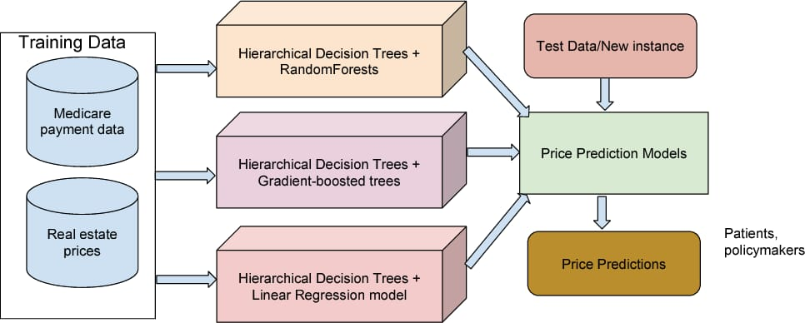
Architecture

Slide 5
Step 1: Data Preprocessing and EDA
Data Cleaning:
Check for missing values and decide on strategies to handle them (e.g., imputation, deletion).
Look for any inconsistencies or outliers in the data and decide how to handle them (e.g., remove outliers, transform values).
Feature Encoding:
Encode categorical variables using techniques like one-hot encoding or label encoding.
Convert any date or time-related features into a usable format.
Feature Scaling:
Standardize or normalize numerical features to ensure they have a similar scale, which can improve the performance of certain machine learning algorithms.
Summary Statistics:
Calculate basic statistics (mean, median, mode, standard deviation, etc.) for numerical features.
Determine the distribution of each feature.
Visualization:
Create visualizations such as histograms, box plots, and scatter plots to understand the distribution and relationships between variables.
Explore correlations between features using correlation matrices or heatmaps.

Slide 6
Step 2: Random Forest
Random Forest is an ensemble learning method used for classification and regression tasks.
It constructs multiple decision trees during training and outputs the mode of the classes (classification) or the mean prediction (regression) of the individual trees.
Each tree in the forest is trained on a random subset of the training data and a random subset of the features, which helps to reduce overfitting and improve generalization.
Random Forest is known for its robustness and ability to handle large datasets with high dimensionality.

Slide 7
Step 3: Multilinear Regression
Multilinear Regression is a statistical method used to model the relationship between a dependent variable and multiple independent variables.
It assumes a linear relationship between the independent variables and the dependent variable.
The goal of multilinear regression is to find the coefficients that minimize the difference between the predicted values and the actual values.
It is simple, interpretable, and can provide insights into the relationships between variables.

Slide 8
Step 4: XGBoost Algorithm
XGBoost is an implementation of gradient boosted decision trees designed for speed and performance.
It sequentially builds a series of decision trees, where each tree corrects the errors of the previous one.
XGBoost is known for its efficiency, scalability, and accuracy in handling large datasets.
It incorporates regularization techniques to prevent overfitting and improve generalization.

Slide 9
Step 5: Connection Between Algorithms
Random Forest and XGBoost are both ensemble learning methods. They combine multiple models (decision trees in this case) to improve predictive performance.
Random Forest constructs a set of decision trees independently and combines their predictions, while XGBoost builds trees sequentially, each one learning from the mistakes of the previous trees.
Both algorithms aim to reduce overfitting and improve generalization by leveraging the wisdom of the crowd, i.e., aggregating predictions from multiple models.

Slide 10
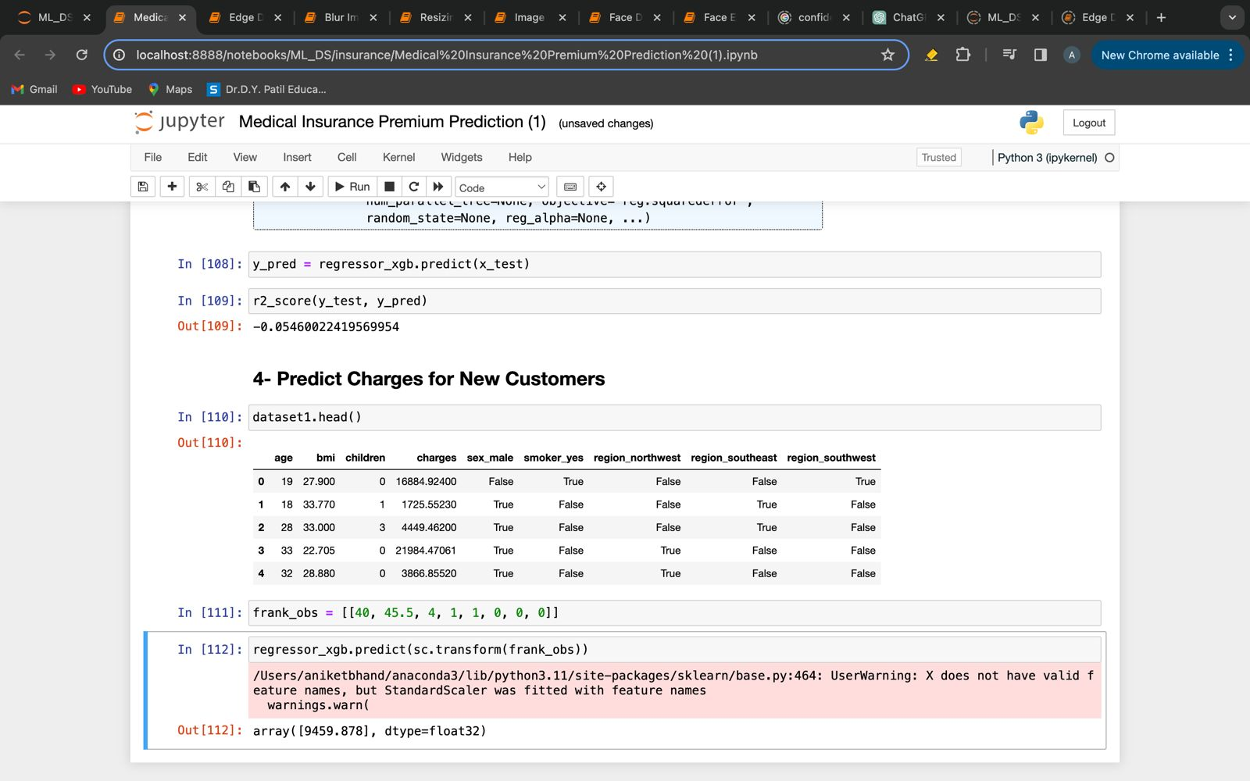
Predict Charges for New Customers
Using the various Algorithms on the dataset we predict charges for new customers.

Slide 11
Frequent Q&A
Q) What is the source of the data?
Data was collected from Kaggle"Machine Learning with R" by Brett Lantz teaches machine learning using R, but Packt Publishing's datasets aren't freely available online, necessitating cleaning and recoding to match the book's format, posing challenges for library borrowers or those relying on friends' copies.
Q) What is the complete flow of your project?
Refer to slide no 4 for better understanding.
Q) What techniques were you using for data pre-processing?
In data pre processing, we analyzed the data, found the important features, and based on the domain knowledge, we eliminated the unnecessary columns. We also tried to fill Missing Values with mean, median and mode but still the data have the same correlations. Thus removing the columns with high NaN values was the better option for us.

Slide 12
Frequent Q&A
Q) How did you choose the model?
The choice of model for medical insurance premium prediction often depends on the complexity of the data and the desired balance between interpretability and predictive accuracy. Commonly used models include regression-based approaches like linear regression or more sophisticated methods such as random forest and gradient boosting algorithms like XGBoost, which handle non-linear relationships and interactions among features effectively, offering robust predictive performance for insurance premium estimation..

Slide 13
Frequent Q&A
Q) For will this project be useful?
A medical insurance premium prediction project is useful because it helps estimate insurance costs accurately, assess risk, engage customers, detect fraud, and make data-driven decisions, benefiting both insurance providers and policyholders.

